Slide 1

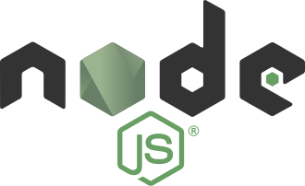

Shun-Yun Hu
Imonology Inc.
2017-03-26

Slide 2


about me
Researcher on scalable virtual worlds
Co-founder of Imonology Inc. (意門科技)
Dad of two veggie kids

Slide 3
structure
Class 1
  node.js intro & install (HTTP server)
  Javascript callbacks (directory viewer)
  Express intro & install (login)
Class 2
  MongoDB intro & install (account CRUD)
  npm module (login system)
  Scalra intro (chatroom)

Slide 4
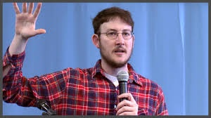
node.js
2009 by Ryan Dahl
Server-side JavaScript
Powered by Google’s V8
Event-driven
Asynchronous I/O (non-blocking)
Real-time Web-apps
npm: 450,000 projects, 2 billion weekly downloads

Slide 5
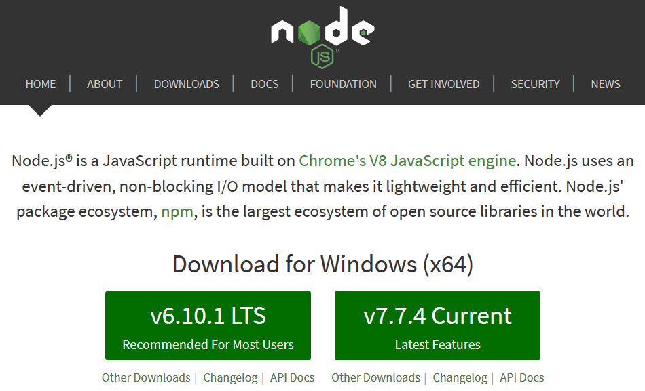
Installation (nodejs.org)

Slide 6

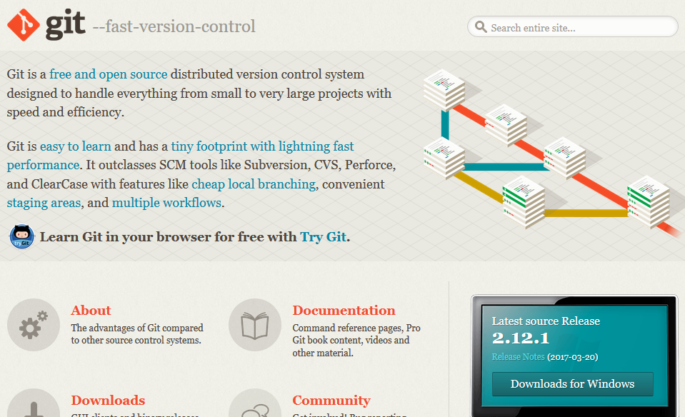
Git (git-scm.com)

Slide 7

check installation

Slide 8
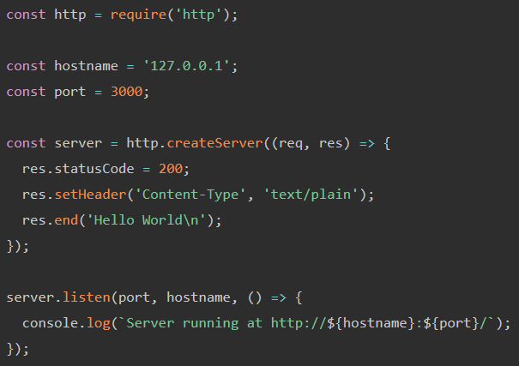
HTTP server (https://nodejs.org/en/about/)
Exercise: return a “Hello World” webpage

Slide 9
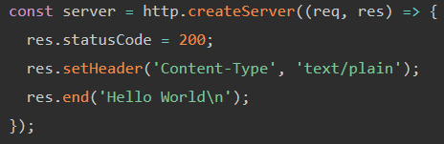
Callbacks?

Slide 10
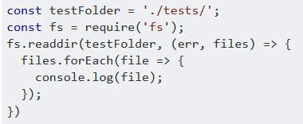
fs: list files in directory
Search: “list files in node”, then check StackOverflow

Slide 11
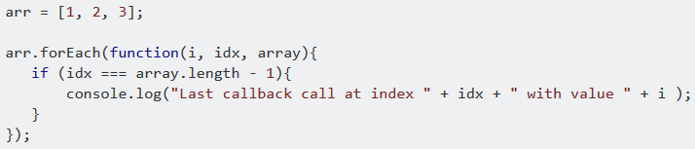
Not working… return after callback is done
Search: “js how to determine foreach ends”

Slide 12
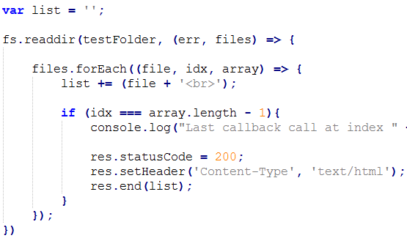
Wait until last before return

Slide 13
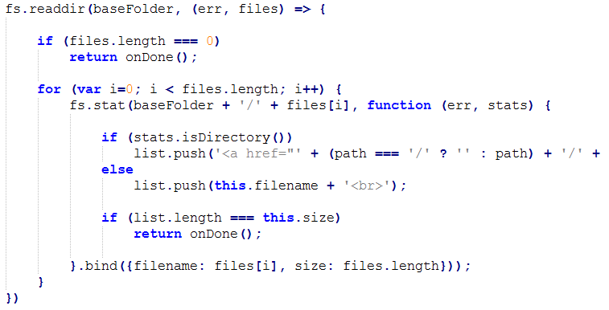
Go to other directories
Exercise: show file content for text files

Slide 14

Express
2010 by TJ Holowaychuk
Fast, unopinionated, minimalist web framework
Server MVC architecture
Works with templating language (EJS, Jade, ..)
Installation
  npm install express

Slide 15
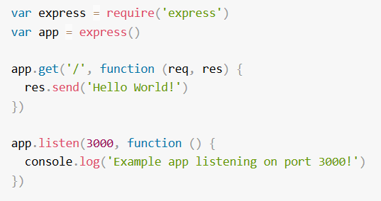
Hello world

Slide 16
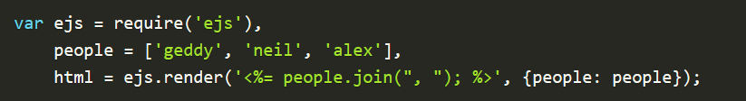
EJS (“effective” JS)
Installation
  npm install ejs

Slide 17
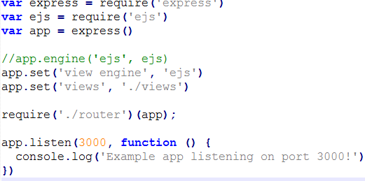
Login sample using ‘router’

Slide 18
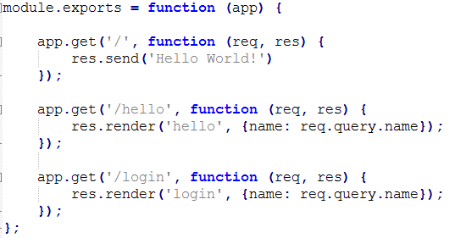
router

Slide 19
Q &A
syhu@imonology.com

